Slide 1
Issue Log 2024 January – September

Slide 2
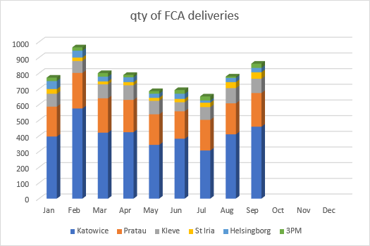
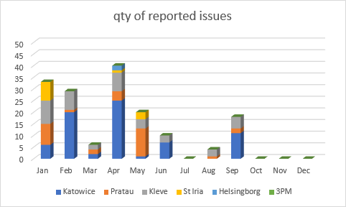
January – September 2024

Slide 3
January – September 2024
Number of issues per month
SU | Jan | Feb | Mar | April | May | June | July | August | Sep | October | Nov | Dec | Total
Katowice | 6 | 20 | 2 | 25 | 1 | 7 | 0 | 0 | 11 | 0 | 0 |  | 72
Pratau | 9 | 1 | 2 | 4 | 12 | 0 | 0 | 1 | 2 | 0 | 0 |  | 31
Kleve | 10 | 8 | 2 | 8 | 4 | 3 | 0 | 3 | 5 | 0 | 0 |  | 43
Helsingborg | 0 | 0 | 0 | 2 | 0 | 0 | 0 | 0 | 0 | 0 | 0 |  | 2
St Iria | 8 | 0 | 0 | 1 | 3 | 0 | 0 | 0 | 0 | 0 | 0 |  | 12
3PM | 0 | 0 | 0 | 0 | 0 | 0 | 0 | 0 | 0 | 0 | 0 |  | 0
Total | 33 | 29 | 6 | 40 | 20 | 10 | 0 | 4 | 18 | 0 | 0 |  | 160
m/m - % change | 0% | -12% | -79% | 80% | -50% | -50% | -100% | 400% ? | 78%
Number of orders versus number of issues
SU | Jan | Feb | March | Apr | May | Jun | Jul | Aug | Sep | Oct | Nov | Dec | Total | nr of issues | % of issues per SU
Katowice | 396 | 575 | 421 | 424 | 343 | 382 | 307 | 410 | 459 | 0 | 0 | 0 | 3717 | 72 | 1.94%
Pratau | 191 | 227 | 219 | 206 | 195 | 175 | 196 | 198 | 215 | 0 | 0 | 0 | 1822 | 31 | 1.70%
Kleve | 82 | 76 | 89 | 93 | 86 | 58 | 81 | 97 | 91 | 0 | 0 | 0 | 753 | 43 | 5.71%
Helsingborg | 51 | 44 | 30 | 31 | 26 | 33 | 28 | 38 | 41 | 0 | 0 | 0 | 322 | 2 | 0.62%
St Iria | 30 | 22 | 19 | 20 | 19 | 21 | 14 | 27 | 28 | 0 | 0 | 0 | 200 | 12 | 6.00%
3PM | 22 | 21 | 23 | 15 | 17 | 24 | 26 | 9 | 27 | 0 | 0 | 0 | 184 | 0 | 0.00%
total | 772 | 965 | 801 | 789 | 686 | 693 | 652 | 779 | 861 | 0 | 942 | 641 | 6998 | 160 | 2.29%

Slide 4
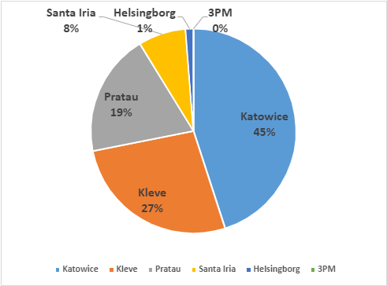
January – September top view per SU
Qty of reported issues | Sum
Katowice | 72
Kleve | 43
Pratau | 31
Santa Iria | 12
Helsingborg | 2
3PM | 0
Sum | 160

Slide 5
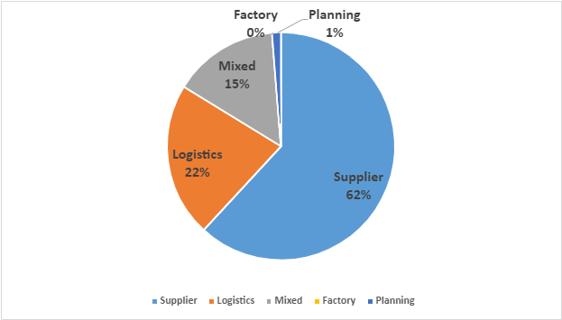
January – September top view per reason code
RC | Nr of issues
Supplier | 99
Logistics | 35
Mixed | 24
Factory | 0
Planning | 2
Total | 160

Slide 6
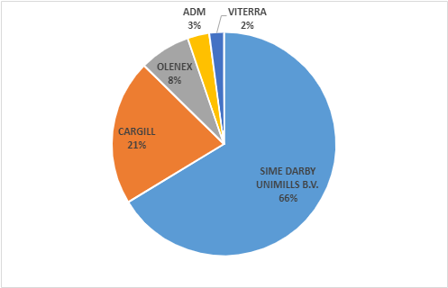
January – September top view per supplier
Supplier | Nr of issues
SIME DARBY UNIMILLS B.V. | 63
CARGILL | 20
OLENEX | 7
ADM | 3
VITERRA | 2

Slide 7
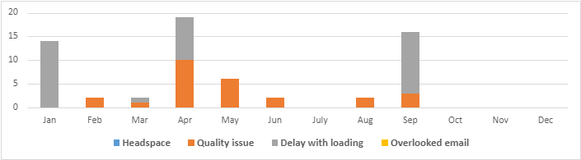
Sime Darby – summary
RC | Jan | Feb | Mar | Apr | May | Jun | July | Aug | Sep | Oct | Nov | Dec | Total
Headspace | 0 | 0 | 0 | 0 | 0 | 0 | 0 | 0 | 0 | 0 | 0 | 0 | 0
Quality issue | 0 | 2 | 1 | 10 | 6 | 2 | 0 | 2 | 3 | 0 | 0 | 0 | 26
Delay with loading | 14 | 0 | 1 | 9 | 0 | 0 | 0 | 0 | 13 | 0 | 0 | 0 | 37
Overlooked email | 0 | 0 | 0 | 0 | 0 | 0 | 0 | 0 | 0 | 0 | 0 | 0 | 0
Total | 14 | 2 | 2 | 19 | 6 | 2 | 0 | 2 | 16 | 0 | 0 | 0 | 63

Slide 8
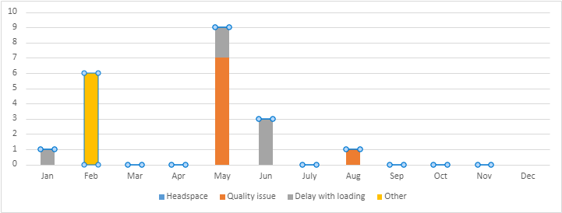
Cargill –summary
RC | Jan | Feb | Mar | Apr | May | Jun | July | Aug | Sep | Oct | Nov | Dec | Total
Headspace | 0 | 0 | 0 | 0 | 0 | 0 | 0 | 0 | 0 | 0 | 0 |  | 0
Quality issue | 0 | 0 | 0 | 0 | 7 | 0 | 0 | 1 | 0 | 0 | 0 |  | 8
Delay with loading | 1 | 0 | 0 | 0 | 2 | 3 | 0 | 0 | 0 | 0 | 0 |  | 6
Other | 0 | 6 | 0 | 0 | 0 | 0 | 0 | 0 | 0 | 0 | 0 |  | 6
Total | 1 | 6 | 0 | 0 | 9 | 3 | 0 | 1 | 0 | 0 | 0 | 0 | 20
*Other – changing of loading place – from Salzgitter to Riesa.

Slide 9
Olenex –summary
RC | Jan | Feb | Mar | Apr | May | Jun | July | Aug | Sep | Oct | Nov | Dec | Total
Headspace | 0 | 0 | 0 | 0 | 0 | 0 | 0 | 0 | 0 | 0 | 0 |  | 0
Quality issue | 0 | 0 | 0 | 0 | 0 | 0 | 0 | 0 | 0 | 0 | 0 |  | 0
Delay with loading | 0 | 0 | 0 | 7 | 0 | 0 | 0 | 0 | 0 | 0 | 0 |  | 7
Other | 0 | 0 | 0 | 0 | 0 | 0 | 0 | 0 | 0 | 0 | 0 |  | 0
Total | 0 | 0 | 0 | 7 | 0 | 0 | 0 | 0 | 0 | 0 | 0 | 0 | 7

Slide 10
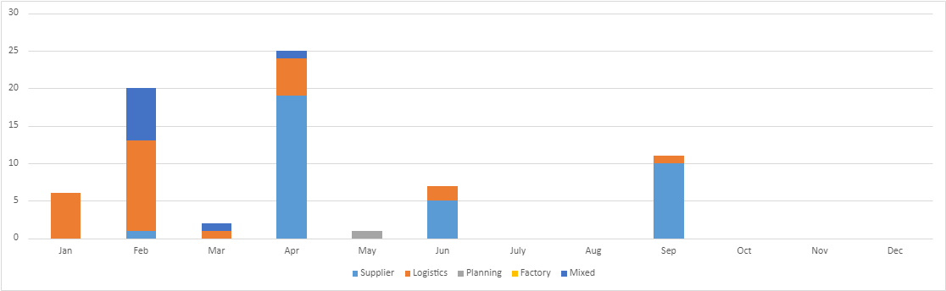
Katowice - overview
RC | Jan | Feb | Mar | Apr | May | Jun | July | Aug | Sep | Oct | Nov | Dec | Total
Supplier | 0 | 1 | 0 | 19 | 0 | 5 | 0 | 0 | 10 | 0 | 0 | 0 | 35
Logistics | 6 | 12 | 1 | 5 | 0 | 2 | 0 | 0 | 1 | 0 | 0 | 0 | 27
Planning | 0 | 0 | 0 | 0 | 1 | 0 | 0 | 0 | 0 | 0 | 0 | 0 | 1
Factory | 0 | 0 | 0 | 0 | 0 | 0 | 0 | 0 | 0 | 0 | 0 | 0 | 0
Mixed | 0 | 7 | 1 | 1 | 0 | 0 | 0 | 0 | 0 | 0 | 0 | 0 | 9
Total | 6 | 20 | 2 | 25 | 1 | 7 | 0 | 0 | 11 | 0 | 0 | 0 | 72

Slide 11
RP Katowice
RC | Jan | Feb | Mar | Apr | May | Jun | July | Aug | Sep | Oct | Nov | Dec | Total
Logistics | 5 | 11 | 0 | 0 | 0 | 0 | 0 | 0 | 0 | 0 | 0 | 0 | 16
Supplier | 0 | 0 | 0 | 7 | 0 | 0 | 0 | 0 | 0 | 0 | 0 | 0 | 7
Mixed | 0 | 7 | 0 | 2 | 0 | 0 | 0 | 0 | 0 | 0 | 0 | 0 | 9
Total | 5 | 18 | 0 | 9 | 0 | 0 | 0 | 0 | 0 | 0 | 0 | 0 | 32

Slide 12
RP Katowice
Logistics:
- 5 orders didn’t load on time (explanation not clear)
- 11 orders didn’t arrive on time due to farmers strike
Supplier:
- 6 orders haven’t been loaded on time (technical issue)
- 1 order – wrong document, missing PO number
Mixed:
- 7 incorrect delivery date/time – changed by supplier plus carrier
- 2 orders – financial problems with contract

Slide 13
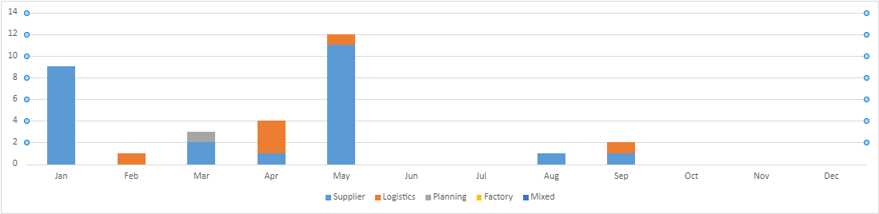
Pratau - overview
RC | Jan | Feb | Mar | Apr | May | Jun | Jul | Aug | Sep | Oct | Nov | Dec | Total
Supplier | 9 | 0 | 2 | 1 | 11 | 0 | 0 | 1 | 1 | 0 | 0 | 0 | 25
Logistics | 0 | 1 | 0 | 3 | 1 | 0 | 0 | 0 | 1 | 0 | 0 | 0 | 6
Planning | 0 | 0 | 1 | 0 | 0 | 0 | 0 | 0 | 0 | 0 | 0 | 0 | 1
Factory | 0 | 0 | 0 | 0 | 0 | 0 | 0 | 0 | 0 | 0 | 0 | 0 | 0
Mixed | 0 | 0 | 0 | 0 | 0 | 0 | 0 | 0 | 0 | 0 | 0 | 0 | 0
Total | 9 | 1 | 3 | 4 | 12 | 0 | 0 | 1 | 2 | 0 | 0 | 0 | 32

Slide 14
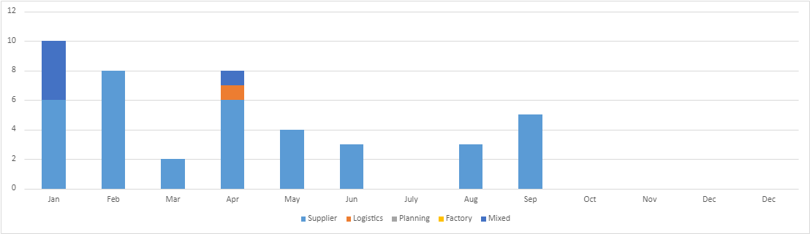
Kleve - overview
RC | Jan | Feb | Mar | Apr | May | Jun | July | Aug | Sep | Oct | Nov | Dec | Dec | Total
Supplier | 6 | 8 | 2 | 6 | 4 | 3 | 0 | 3 | 5 | 0 | 0 | 0 | 0 | 37
Logistics | 0 | 0 | 0 | 1 | 0 | 0 | 0 | 0 | 0 | 0 | 0 | 0 | 0 | 1
Planning | 0 | 0 | 0 | 0 | 0 | 0 | 0 | 0 | 0 | 0 | 0 | 0 | 0 | 0
Factory | 0 | 0 | 0 | 0 | 0 | 0 | 0 | 0 | 0 | 0 | 0 | 0 | 0 | 0
Mixed | 4 | 0 | 0 | 1 | 0 | 0 | 0 | 0 | 0 | 0 | 0 | 0 | 0 | 5
Total | 10 | 8 | 2 | 8 | 4 | 3 | 0 | 3 | 5 | 0 | 0 | 0 | 0 | 43

Slide 15
January – March top view logistics issues per carrier
Carrier | Jan | Feb | Mar | Apr | Total | % of total | Nr of issues | % of issues
Anbud | 312 | 361 | 329 | 330 | 1332 | 40% | 16 | 1%
HS | 102 | 146 | 99 | 108 | 455 | 14% | 3 | 1%
VDB | 84 | 89 | 93 | 73 | 339 | 10% | 1 | 0%
ITC | 72 | 58 | 73 | 77 | 280 | 8% | 0 | 0%
OMEGA | 32 | 94 | 73 | 28 | 227 | 7% | 9 | 4%
PAWTRANS | 42 | 98 | 38 | 49 | 227 | 7% | 0 | 0%
We have stopped cooperation with Omega due to lots of issues with deliveries (milk, late delivery etc.)

